Slide 1
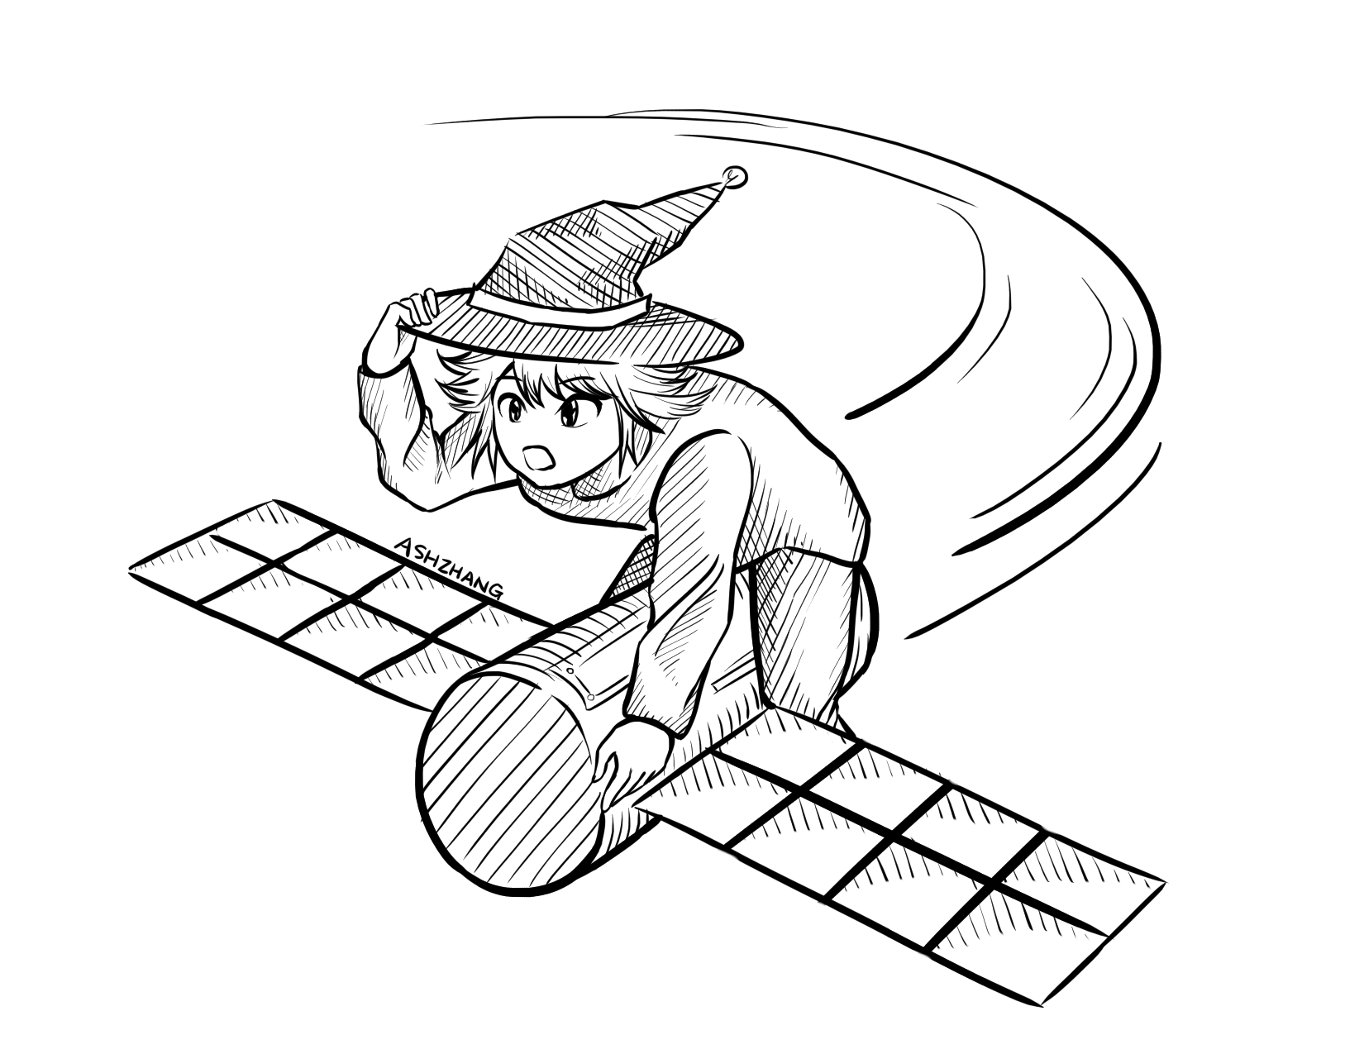
Block Cipher Modes of Operation
CSE 405 July 2023
Lecture 4

Slide 2
Summary: One-Time Pads
One-time pads
Symmetric encryption scheme: Alice and Bob share a secret key.
Encryption and decryption: Bitwise XOR with the key.
No information leakage if the key is never reused.
Information leaks if the key is reused.
Impractical for real-world usage, unless you’re a spy.

Slide 3
Summary: Block Ciphers
Encryption: input a k-bit key and n-bit plaintext, receive n-bit ciphertext
Decryption: input a k-bit key and n-bit ciphertext, receive n-bit plaintext
Correctness: when the key is fixed, EK(M) should be bijective
Security
Without the key, EK(m) is computationally indistinguishable from a random permutation
Brute-force attacks take astronomically long and are not possible
Efficiency: algorithms use XORs and bit-shifting (very fast)
Implementation: AES is the modern standard
Issues
Not IND-CPA secure because they’re deterministic
Can only encrypt n-bit messages

Slide 4
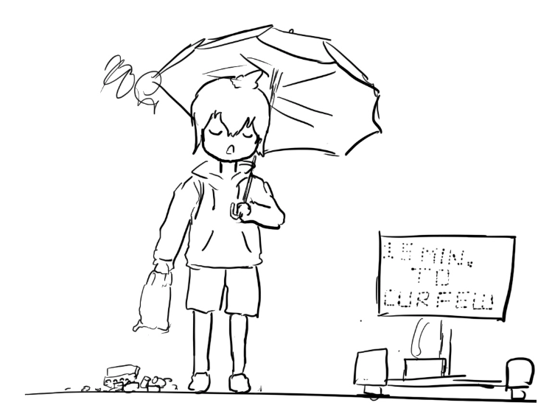
Block Cipher Modes of Operation
Textbook Chapter 6.6–6.9

Slide 5
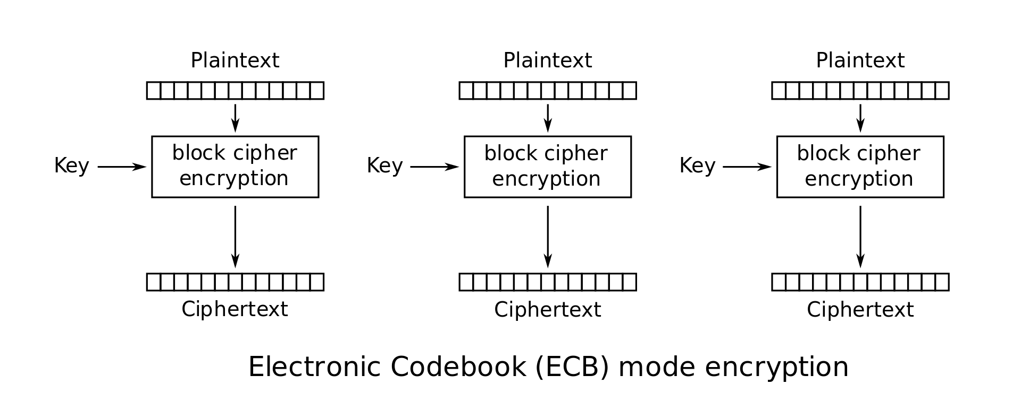
Scratchpad: Let’s design it together
Here’s an AES block. Remember that it can only encrypt 128-bit messages.
How can we use AES to encrypt a longer message (say, 256 bits?)

Slide 6
Scratchpad: Let’s design it together
Idea: Let’s use AES twice!
First 128 bits of message
Second 128 bits of message

Slide 7
Scratchpad: Let’s design it together
Note that we are using the same key twice. We want to avoid a situation like one-time pads where we need very long keys.

Slide 8
ECB Mode
We’ve just designed electronic code book (ECB) mode
Enc(K, M) = C1 || C2 || … || Cm
Assume m is the number of blocks of plaintext in M, each of size n
AES-ECB is not IND-CPA secure. Why?
Because ECB is deterministic

Slide 9

ECB Mode: Penguin
Original image

Slide 10

ECB Mode: Penguin
Encrypted with ECB

Slide 11
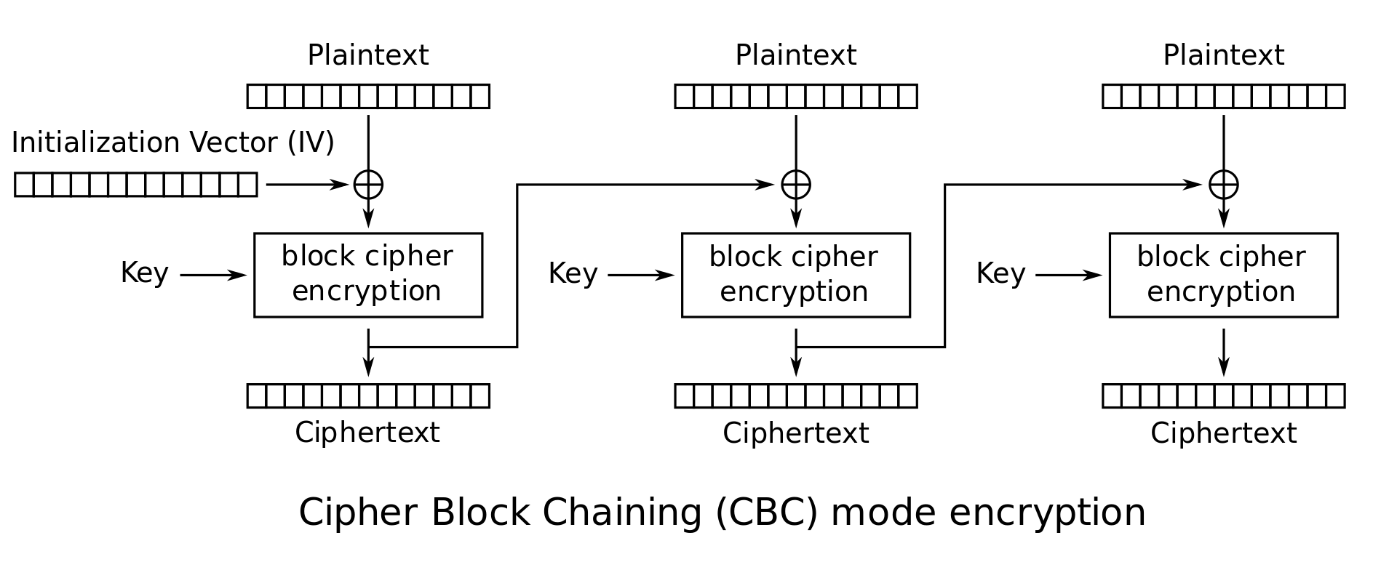
Scratchpad: Let’s design it together
Here’s ECB mode. It’s not IND-CPA secure because it’s deterministic.
Let’s fix that by adding some randomness.
Notes:
If students propose adding

Slide 12
Scratchpad: Let’s design it together
The Initialization Vector (IV) is different for every encryption. Now the first ciphertext block will be different for every encryption!
Okay, but the other blocks are still deterministic...
Notes:
If students propose adding

Slide 13
Scratchpad: Let’s design it together
Idea: The first ciphertext block was computed with some randomness. Let’s use it to add randomness to the second block.
Notes:
If students propose adding

Slide 14
Scratchpad: Let’s design it together
Now the second ciphertext block has some randomness in it. Let’s use it to add randomness to the third block.
Notes:
If students propose adding

Slide 15
CBC Mode
We’ve just designed cipher block chaining (CBC) mode
Ci = EK(Mi ⊕ Ci-1); C0 = IV
Enc(K, M):
Split M in m plaintext blocks P₁ … P_{m} each of size n
Choose a random IV
Compute and output (IV, C₁, …, C_{m}) as the overall ciphertext
How do we decrypt?
P₁
P₂
P_{m}

Slide 16
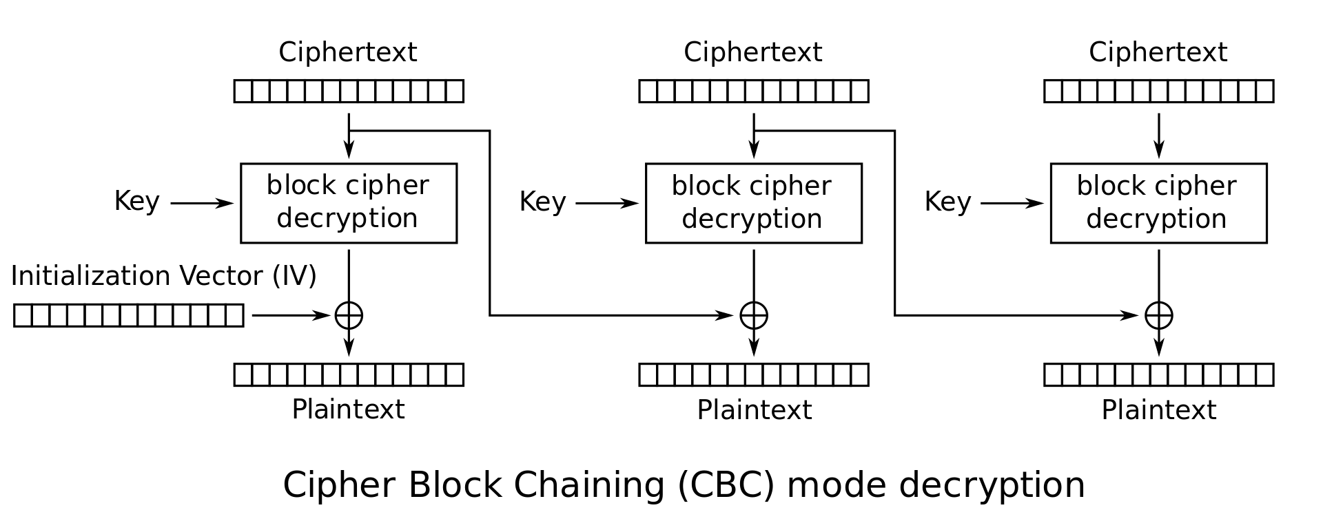
CBC Mode: Decryption
How do we decrypt CBC mode?
Parse ciphertext as (IV, C₁, …, C_{m})
Decrypt each ciphertext and then XOR with IV or previous ciphertext

Slide 17
CBC Mode: Decryption
Ci | = | EK(Mi ⊕ Ci-1) | Definition of encryption
DK(Ci) | = | DK(EK(Mi ⊕ Ci-1)) | Decrypting both sides
DK(Ci) | = | Mi ⊕ Ci-1 | Decryption and encryption cancel
DK(Ci) ⊕ Ci-1 | = | Mi ⊕ Ci-1 ⊕ Ci-1 | XOR both sides with Ci-1
DK(Ci) ⊕ Ci-1 | = | Mi | XOR property

Slide 18
CBC Mode: Efficiency & Parallelism
Can encryption be parallelized?
No, we have to wait for block i to finish before encrypting block i+1
Can decryption be parallelized?
Yes, decryption only requires ciphertext as input

Slide 19
CBC Mode: Padding
What if you want to encrypt a message that isn’t a multiple of the block size?
AES-CBC is only defined if the plaintext length is a multiple of the block size
Solution: Pad the message until it’s a multiple of the block size
Padding: Adding dummy bytes at the end of the message until it’s the proper length

Slide 20
CBC Mode: Padding
What padding scheme should we use?
Padding with 0’s?
Doesn’t work: What if our message already ends with 0’s?
Padding with 1’s?
Same problem
We need a scheme that can be unpadded without ambiguity
One scheme that works: Append a 1, then pad with 0’s
If plaintext is multiple of n, you still need to pad with an entire block
Another scheme: Pad with the number of padding bytes
So if you need 1 byte, pad with 01; if you need 3 bytes, pad with 03 03 03
If you need 0 padding bytes, pad an entire dummy block
This is called PKCS #7
Notes:
Ask: Ideas for unambiguous padding schemes

Slide 21
CBC Mode: Security
AES-CBC is IND-CPA secure. With what assumption?
The IV must be randomly generated and never reused
What happens if you reuse the IV?
The scheme becomes deterministic: No more IND-CPA security

Slide 22
CBC Mode: IV Reuse
Consider two three-block messages: P1P2P3 and P1P2P4
The first two blocks are the same for both messages, but the last block is different
What if we encrypt them with the same IV?
When the IV is reused, CBC mode reveals when two messages start with the same plaintext blocks, up to the first different plaintext block

Slide 23
CBC Mode is IND-CPA (when used correctly)
Enc(K, M):
Split M in m plaintext blocks P1 … Pm each of size n
Choose random IV, compute and output (IV, C1, …, Cm) as the overall ciphertext
Why IND-CPA?
If there exists an attacker that wins in the IND-CPA game, then there exists an attacker that breaks the block cipher security. Proof is out of scope.
P₁
P₂
P_{m}

Slide 24
CBC Mode: Penguin
Original image

Slide 25

CBC Mode: Penguin
Encrypted with CBC, with random IVs

Slide 26
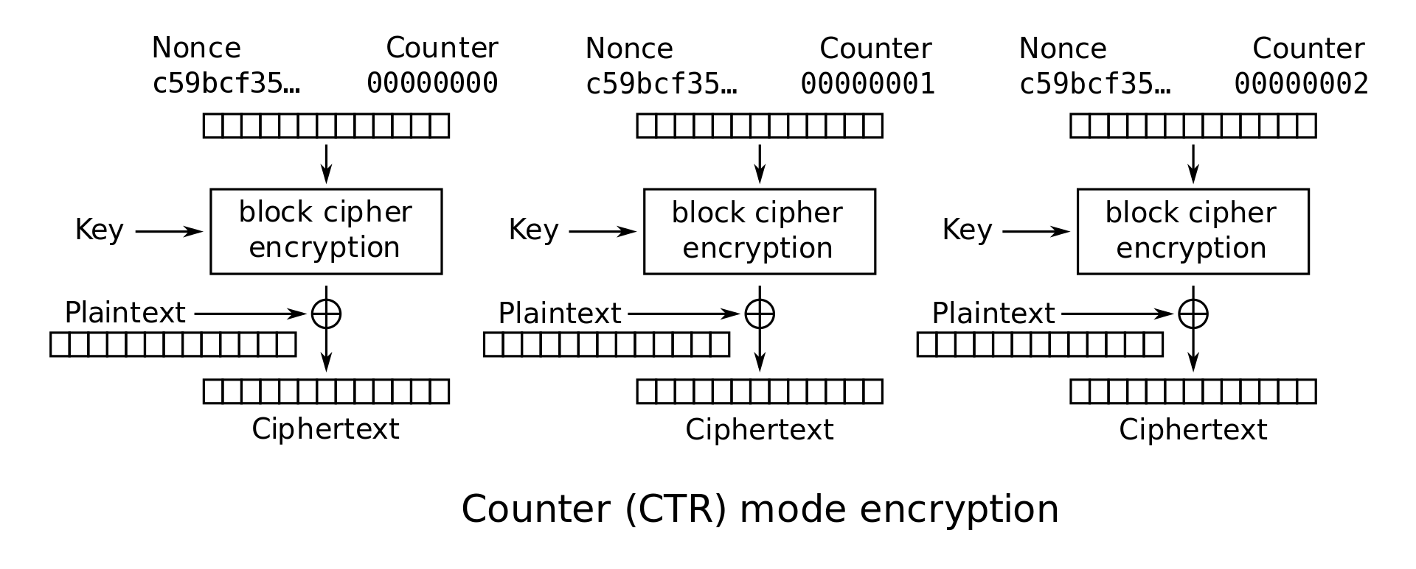
CTR Mode Scratchpad: Let’s design it together
One-time pads are secure if we never reuse the key.
Key

Slide 27
CTR Mode Scratchpad: Let’s design it together
If the attacker doesn’t know the key, the block cipher output looks random.
New idea: Can we use block ciphers to simulate a one-time pad?

Slide 28
CTR Mode Scratchpad: Let’s design it together
If the attacker doesn’t know the key, all of these outputs look random.

Slide 29
CTR Mode Scratchpad: Let’s design it together
Idea: Use this random-looking output as a one-time pad!
Remember one-time pads: XOR the pad with plaintext to get ciphertext

Slide 30
CTR Mode Scratchpad: Let’s design it together
What do we use as input to the block cipher?

Slide 31
CTR Mode Scratchpad: Let’s design it together
IND-CPA schemes need randomness, so let’s put a random nonce here!

Slide 32
CTR Mode Scratchpad: Let’s design it together
The counter increments per block to ensure each block cipher output is different.

Slide 33
CTR (Counter) Mode
Note: the random value is named the nonce here, but the idea is the same as the IV in CBC mode
Overall ciphertext is (Nonce, C₁, …, C_{m})
C₁
C_{m}

Slide 34
CTR Mode
Enc(K, M):
Split M in plaintext blocks P₁...P_{m} (each of block size n)
Choose random nonce
Compute and output (Nonce, C₁, …, C_{m})
How do you decrypt?
C₁
C_{m}

Slide 35
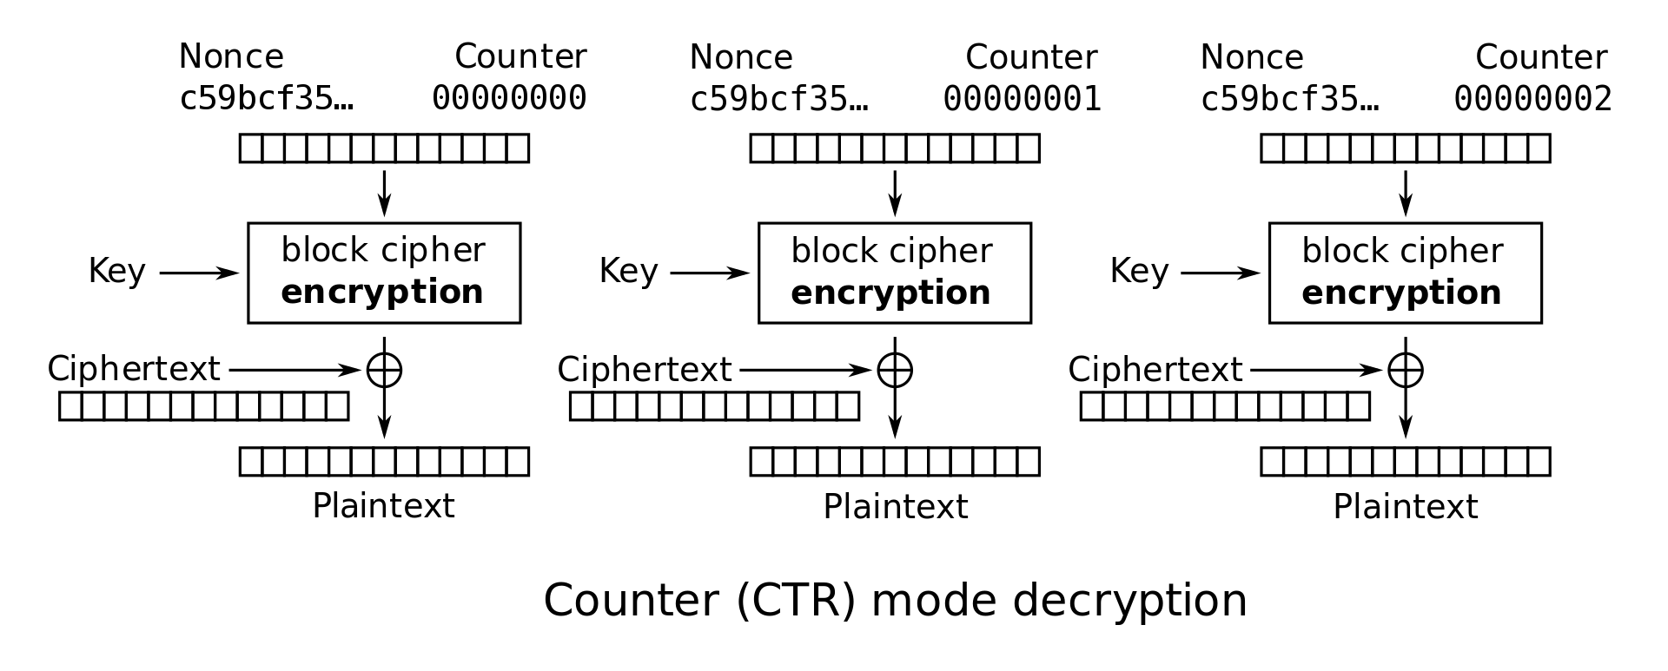
CTR Mode: Decryption
Recall one-time pad: XOR with ciphertext to get plaintext
Note: we are only using block cipher encryption, not decryption

Slide 36
CTR Mode: Decryption
Dec(K, C):
Parse C into (nonce, C₁, …, C_{m})
Compute P_{i} by XORing Ci with output of E_{k} on nonce and counter
Concatenate resulting plaintexts and output M = P₁ … P_{m}
C₁
C₂
C_{m}

Slide 37
CTR Mode: Efficiency
Can encryption be parallelized?
Yes
Can decryption be parallelized?
Yes

Slide 38
CTR Mode: Padding
Do we need to pad messages?
No! We can just cut off the parts of the XOR that are longer than the message.

Slide 39
CTR Mode: Security
AES-CTR is IND-CPA secure. With what assumption?
The nonce must be randomly generated and never reused
And in general less than 2^{n/2} blocks are encrypted
What happens if you reuse the nonce?
Equivalent to reusing a key in a one-time pad
Recall: Key reuse in a one-time pad is catastrophic: usually leaks enough information for an attacker to deduce the entire plaintext
Notes:
TODO (elaborate on encrypting more than 2^{n/2} blocks)

Slide 40
CTR Mode: Penguin
Original image

Slide 41
CTR Mode: Penguin
Encrypted with CTR, with random nonces

Slide 42
The summer 2020 CS 61A exam mistake
The TAs used a Python library for AES
A bad library for other reasons besides this example
When they invoked CTR mode encryption, they didn’t specify an IV
Assumption: the crypto library would add a random IV for them
Reality: the crypto library defaulted to IV = 0 every time
The same IV was used to encrypt multiple exam questions
All security was lost!
Any CS 161 student could have seen the exam beforehand
Takeaway: Do not reuse IVs
Takeaway: Real world cryptosystems are hard. You do not have the skills necessary to build real world cryptosystems. I don’t either.

Slide 43
IVs and Nonces
Initialization vector (IV): A random, but public, one-use value to introduce randomness into the algorithm
For CTR mode, we say that you use a nonce (number used once), since the value has to be unique, not necessarily random.
In this class, we use IV and nonce interchangeably
Never reuse IVs
In some algorithms, IV/nonce reuse leaks limited information (e.g. CBC)
In some algorithms, IV/nonce reuse leads to catastrophic failure (e.g. CTR)

Slide 44
IVs and Nonces
Thinking about the consequences of IV/nonce reuse is hard
What if the IV/nonce is not reused, but the attacker can predict future values?
Now you have to think about more attacks
We’ll analyze this more in discussion: it really depends on the encryption function
Solution: Randomly generate a new IV/nonce for every encryption
If the nonce is 128 bits or longer, the probability of generating the same IV/nonce twice is astronomically small (basically 0)
Now you don’t ever have to think about IV/nonce reuse attacks!

Slide 45
Comparing Modes of Operation
If you need high performance, which mode is better?
CTR mode, because you can parallelize both encryption and decryption
If you’re paranoid about security, which mode is better?
CBC mode is better
Theoretically, CBC and CTR mode are equally secure if used properly
However, if used improperly (IV/nonce reuse), CBC only leaks partial information, and CTR fails catastrophically
Consider human factors: Systems should be as secure as possible even when implemented incorrectly
IV failures on CTR mode have resulted in multiple real-world security incidents!

Slide 46
Other Modes of Operation
Other modes exist besides CBC and CTR
Trade-offs:
Do we need to pad messages?
How robust is the scheme if we use it incorrectly?
Can we parallelize encryption/decryption?

Slide 47
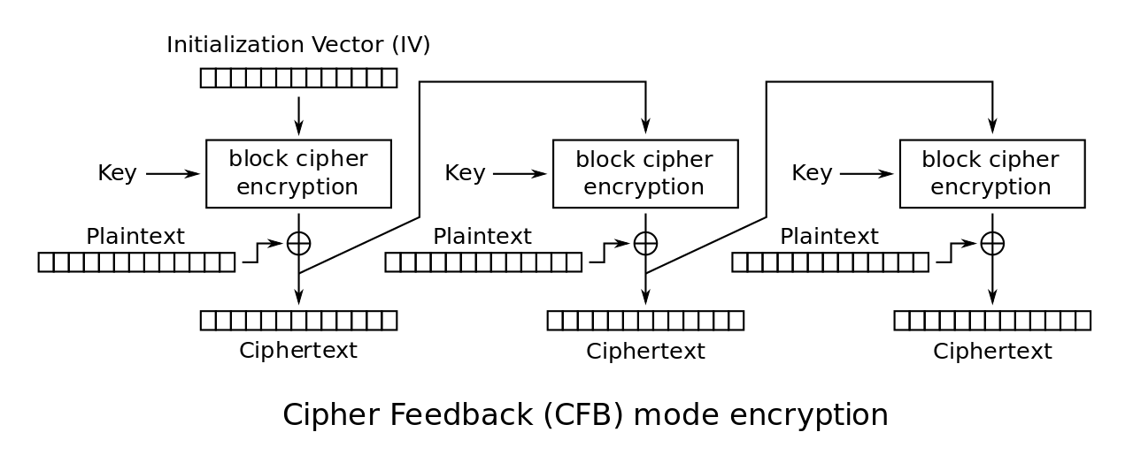
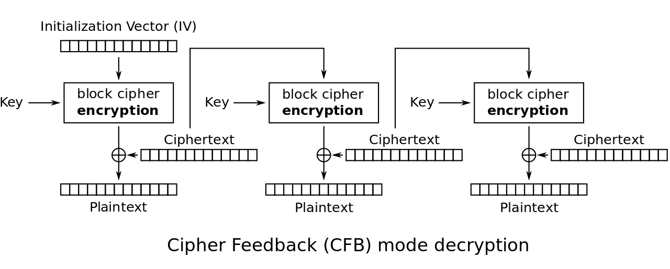
CFB Mode
Also IND-CPA
Try to analyze the trade-offs yourself:
Do we need to pad messages?
How robust is the scheme if we use it incorrectly?
Can we parallelize encryption/decryption?

Slide 48
CFB Mode
Try to analyze the trade-offs yourself:
Do we need to pad messages?
No
How robust is the scheme if we use it incorrectly?
Similar effects as CBC mode, but a bit worse if you reuse the IV
Can we parallelize encryption/decryption?
Only decryption is parallelizable

Slide 49
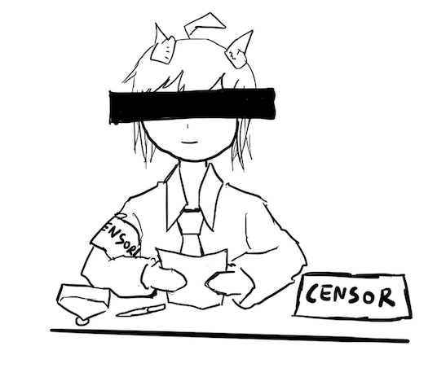
Lack of Integrity and Authenticity
Block ciphers are designed for confidentiality (IND-CPA)
If an attacker tampers with the ciphertext, we are not guaranteed to detect it
Remember Mallory: An active manipulator who wants to tamper with the message

Slide 50
Lack of Integrity and Authenticity
Consider CTR mode
What if Mallory tampers with the ciphertext using XOR?
P | a | y |  | M | a | l |  | $ | 1 | 0 | 0
0x50 | 0x61 | 0x79 | 0x20 | 0x4d | 0x61 | 0x6c | 0x20 | 0x24 | 0x31 | 0x30 | 0x30
M
⊕
EK(i)
0x8a | 0xe3 | 0x5e | 0xcf | 0x3b | 0x40 | 0x46 | 0x57 | 0xb8 | 0x69 | 0xd2 | 0x96
=
C
0xda | 0x82 | 0x27 | 0xef | 0x76 | 0x21 | 0x2a | 0x77 | 0x9c | 0x58 | 0xe2 | 0xa6

Slide 51
Lack of Integrity and Authenticity
Suppose Mallory knows the message M
How can Mallory change the M to say Pay Mal $900?
P | a | y |  | M | a | l |  | $ | 1 | 0 | 0
0x50 | 0x61 | 0x79 | 0x20 | 0x4d | 0x61 | 0x6c | 0x20 | 0x24 | 0x31 | 0x30 | 0x30
M
⊕
EK(i)
0x8a | 0xe3 | 0x5e | 0xcf | 0x3b | 0x40 | 0x46 | 0x57 | 0xb8 | 0x69 | 0xd2 | 0x96
=
C
0xda | 0x82 | 0x27 | 0xef | 0x76 | 0x21 | 0x2a | 0x77 | 0x9c | 0x58 | 0xe2 | 0xa6

Slide 52
Lack of Integrity and Authenticity
Ci | = | Mi ⊕ Padi | 0x58 | = | 0x31 ⊕ Padi | Definition of CTR
Padi | = | Mi ⊕ Ci | Padi | = | 0x58 ⊕ 0x31 | Solve for the ith byte of the pad
 |  |  |  | = | 0x69
C'i | = | M'i ⊕ Padi | C'i | = | 0x39 ⊕ 0x69 | Compute the changed ith byte
 |  |  |  | = | 0x50
C
0xda | 0x82 | 0x27 | 0xef | 0x76 | 0x21 | 0x2a | 0x77 | 0x9c | 0x58 | 0xe2 | 0xa6
C’
0xda | 0x82 | 0x27 | 0xef | 0x76 | 0x21 | 0x2a | 0x77 | 0x9c | 0x50 | 0xe2 | 0xa6

Slide 53
Lack of Integrity and Authenticity
What happens when we decrypt C'?
The message looks like “Pay Mal $900” now!
Note: Mallory didn’t have to know the key; no integrity or authenticity for CTR mode!
C'
0xda | 0x82 | 0x27 | 0xef | 0x76 | 0x21 | 0x2a | 0x77 | 0x9c | 0x50 | 0xe2 | 0xa6
⊕
EK(i)
0x8a | 0xe3 | 0x5e | 0xcf | 0x3b | 0x40 | 0x46 | 0x57 | 0xb8 | 0x69 | 0xd2 | 0x96
=
P'
0x50 | 0x61 | 0x79 | 0x20 | 0x4d | 0x61 | 0x6c | 0x20 | 0x24 | 0x39 | 0x30 | 0x30
P | a | y |  | M | a | l |  | $ | 9 | 0 | 0

Slide 54
Lack of Integrity and Authenticity
What about CBC?
Altering a bit of the ciphertext causes some blocks to become random gibberish
However, Bob cannot prove that Alice did not send random gibberish, so it still does not provide integrity or authenticity

Slide 55
Block Cipher Modes of Operation: Summary
ECB mode: Deterministic, so not IND-CPA secure
CBC mode
IND-CPA secure, assuming no IV reuse
Encryption is not parallelizable
Decryption is parallelizable
Must pad plaintext to a multiple of the block size
IV reuse leads to leaking the existence of identical blocks at the start of the message
CTR mode
IND-CPA secure, assuming no IV reuse
Encryption and decryption are parallelizable
Plaintext does not need to be padded
Nonce reuse leads to losing all security
Lack of integrity and authenticity

